Slide 1

Iteration And Prototyping
formative evaluation-
Prototype that is acceptable
Room for improvement
intended to improve designs
summative evaluation
performed at the end to verify whether the product is good enough.
a real-use environment

Slide 2
Contn…
best practice’ approach for interaction design.
Hill climbing
you start somewhere, evaluate it to see how to make it better, change it to make it better and then keep on doing this until it can’t get any better.

Slide 3
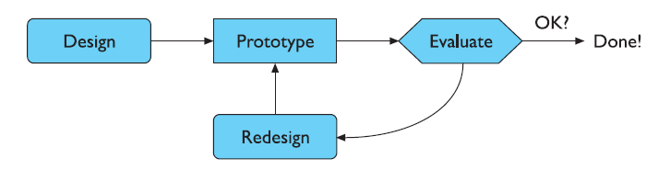
Contn…
two things you need in order for prototyping
1. To understand what is wrong and how to improve.
2. A good start point.

Slide 4
HCI in the software process

Slide 5
Software Engineering
Software engineering is the discipline for understanding the software design process, or life cycle (SDLC)
Designing for usability occurs at all stages of the life cycle, not as a single isolated activity

Slide 6
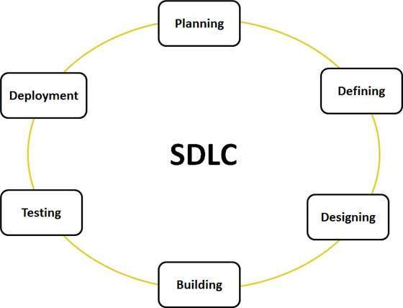
Software lifecycle

Slide 7
6 phases in software lifecycle
Requirements specification
Defining the requirements
Architectural design
Development and unit testing
Integration and testing
Operation and maintenance

Slide 8
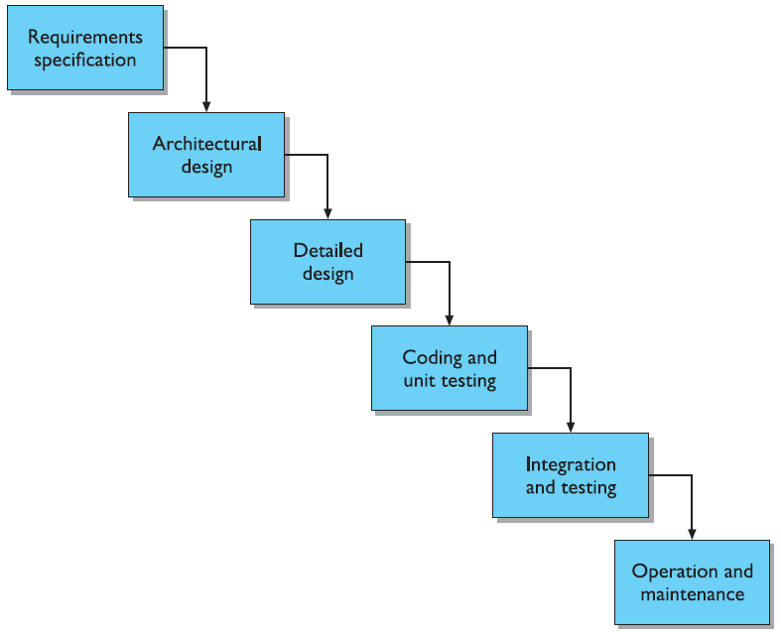
The software lifecycle:The waterfall model

Slide 9
1. Requirement specification
Designer and user (customer) try capture what the system is expected to provide
It can be expressed in natural language
or more precise languages, such as a task analysis would provide
The requirements are collected using a number of practices as given
Studying the existing or obsolete system and software,
Conducting interviews of users and developers,
Referring to the database or
Collecting answers from the questionnaires.

Slide 10
2. Defining the requirements
The next step is to clearly define and document the product requirements and get them approved from the customer or the market analysts.
This is done through SRS. Software Requirement Specification document
It consists of all the product requirements to be designed and developed during the project life cycle.

Slide 11
3. Architectural design
High-level description of how the system will provide the services
How it satisfy both functional and non functional requirements
SRS is the reference for product architects to come out with the best architecture for the product to be developed. Based on the requirements specified in SRS, the best design approach is selected for the product and documented in a DDS - Design Document Specification.

Slide 12
4. Development and unit testing
The programming code is generated as per DDS during this stage.
If the design is performed in a detailed and organized manner, code generation can be accomplished without much hassle.
Developers have to follow the coding guidelines defined by their organization and programming tools like compilers, interpreters, debuggers etc are used to generate the code.

Slide 13
5. Integration and testing
This stage of SDLC is involved in the integration of software with outer world entities.
Software may need to be integrated with the libraries, databases and other program(s).
Also, during this stage, the product defects are reported, tracked, fixed and retested, until the product reaches the quality standards defined in the SRS.

Slide 14
6. Operation and maintenance
This phase confirms the software operation in terms of more efficiency and less errors.
If required, the users are trained on, or aided with the documentation on how to operate the software and how to keep the software operational.

Slide 15
Verification and validation
Each step contains verification and validation
Verification:
Correct/Consistent representation of previous stage
It should produce correct results for correct inputs
Designing the right product
Validation:
Check product to ensure results are conform requirements
It should produce error for incorrect inputs
Designing the product right

Slide 16
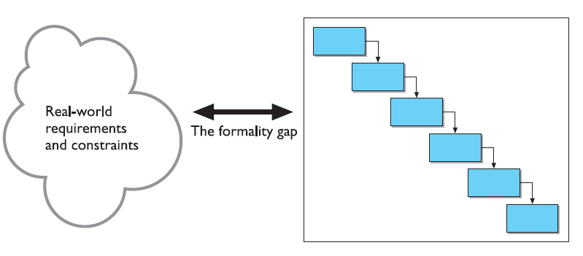
Verification and validation
The formality gap
validation will always rely to some extent on subjective means of proof
Management and contractual issues
design in commercial and legal contexts

Slide 17
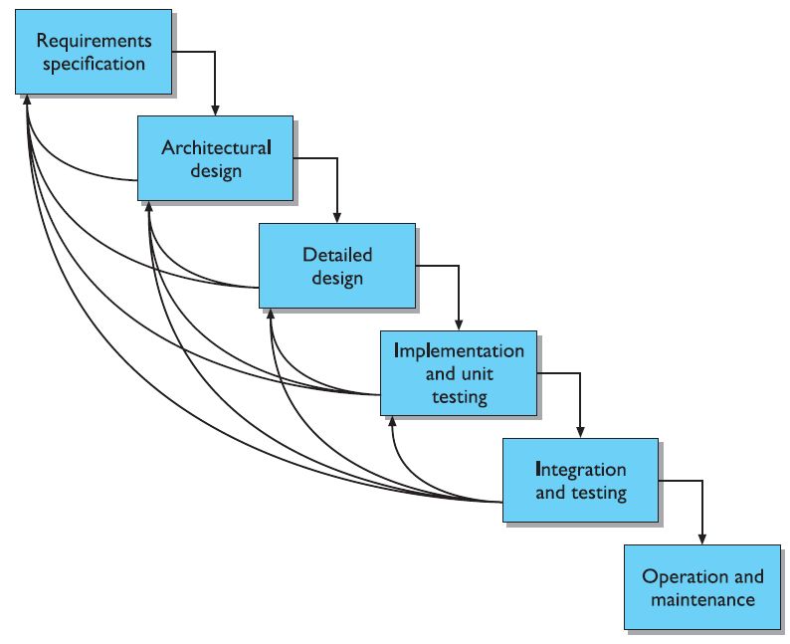
The life cycle for interactive systems
cannot assume a linear sequence of activities as in the waterfall model
lots of feedback!

Slide 18
HCI life-cycle
Design
Process of developing artefacts
Various representations of artefacts during design
Look at user-centered design
Development
Producing range of representations until suitable artefacts is built
Representations (models): formal + informal
Users
Model of users
Look at several models for the design process

Slide 19
S/W Engineering HCI
Identifies issues (entities) of significance to system
Functionally oriented, data driven
Design notation: to be understood by system analysts
Dataflow diagrams
Entity Relationship Diagrams
Resistance by future users
Identifies issues (entities) of practical effectiveness
Usability oriented, user driven
Design notation: to be understood by users
Task Analysis (diagrams)
Scenarios
Screen sketch
Prototype

Slide 20
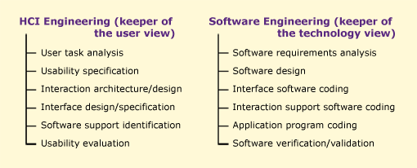
S/W Engineering and HCI
HCI Engineering and Software Engineering are keepers of different views.

Slide 21
The process of design (Recap)
Scenarios Task analysis
what is wanted
Guidelines
Principles
Standards
analysis
Interviews
Ethnography
what is there
vs.
what is wanted
Precise Specification
design
Dialogue Notations
implement
and deploy
Evaluation
Heuristics
prototype
Architectures
Documentation
Help

Slide 22
Software Quality (ISO 9126)
Metrics and Evaluation
Functionality
Reliability
Usability
Efficiency
Maintainability
Portability
PM Accessibility (sometimes relevant, not ISO 9126)

Slide 23
Definition of Usability (Nielsen 2003)
Usability: how well users can use the system’s functionality
Usability is a quality attribute that assesses how easy user interfaces are to use
The word ‘usability’ also refers to methods for improving ease-of-use during the design process

Slide 24
Usability Components
Learnability
Ease of learning the system, i.e. the basic tasks
Skills retained over time (also Memorability)
Throughput (also Efficiency)
Speed of task performance
Low user error rate
Flexibility
Suitability for intended user expertise
Can system be customized?
Attitude (also Satisfaction)
User subjective satisfaction with system

Slide 25
The 5E’s to Usability
Easy to learn
Supports initial learning and continued learning
Efficient
The speed in which users complete their tasks
Error tolerant
The ability of the interface to prevent errors or help users recover from those that occur
Effective
The completeness and accuracy with which users achieve their goals
Engaging
How pleasant or satisfying the interface is to use?

Slide 26
Usability Components (Dimensions of usability)
Learnability: is it easy to learn?
Memorability: is it easy to remember what you learned?
Efficiency: once learned, is it fast to use?
Errors: are errors few and recoverable?
Satisfaction: is it enjoyable to use?

Slide 27
Usability Engineering
The test of usability based on measurement of user experience
It demands that specific usability measures be made explicit as requirements
Usability Measurements
Usability attribute/principle
Measuring concept
Measuring method
Now level/ worst case/ planned level/ best case

Slide 28
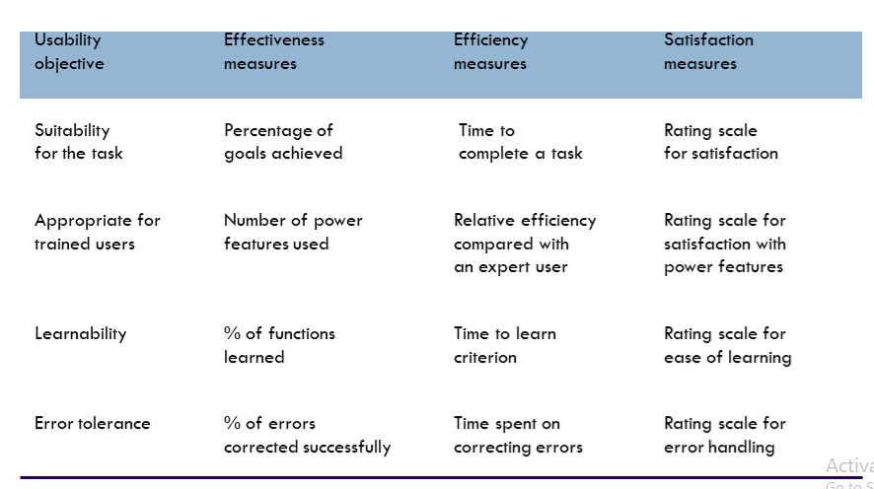
Some metrics from ISO 9241

Slide 29
Usability Engineering (contd.)
Problems
usability specification requires level of detail that may not be
possible early in design satisfying a usability specification
does not necessarily satisfy usability

Slide 30
Case Study-ATM (from L9)
Researchers + banks expected ATMs to be intuitively easy to use
Testing among senior citizens found only 20% correct operation
Senior citizens often put off by ATMs they find the machines
Complicated
Inconvenient

Slide 31
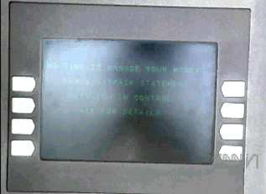
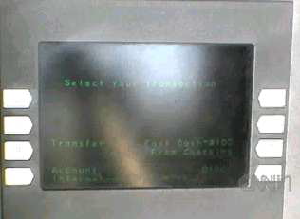
Problems with ATMs
Buttons that did not line up with commands
Screens hard to read in the glare of daylight
Sometimes confusing menu choices

Slide 32
Usability suggestions
Simpler on-screen instructions
More “undo” buttons
Bank should provide training for any customers who need it
Remark:
“Large percentage” of people surveyed said they would use ATMs if trained

Slide 33
prototyping

Slide 34
Prototyping
Prototyping is common in almost every field of engineering design
In prototyping one has to plan to throw away

Slide 35
Why prototype?
Get feedback earlier, cheaper
Experiment with alternatives
Easier to change to throw away

Slide 36
Prototyping the User-Interface
Identifying user interface requirements
Almost impossible to specify in advance
Supported by good software tools
Graphical editors, construction kits
User Interface Management Systems (UIMS)
Wireframes
“Prototyping does NOT mean ‘build in haste’”

Slide 37
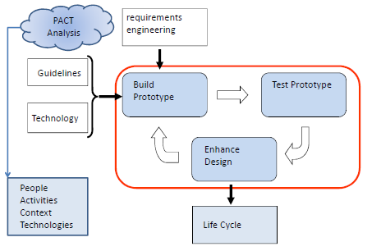
Prototyping the user interface

Slide 38
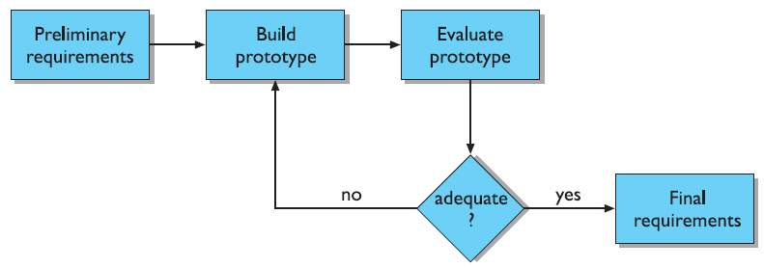
Throw-away
The prototype is built and tested.
The design knowledge gained from this exercise is used to build the final product, but the actual prototype is discarded.

Slide 39
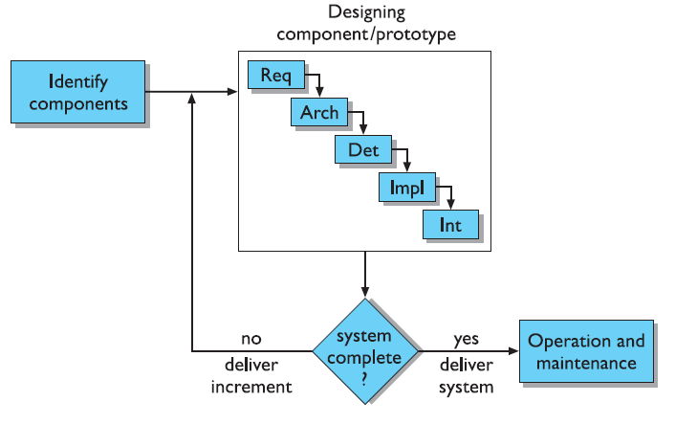
Incremental
The final product is built as separate components, one at a time

Slide 40
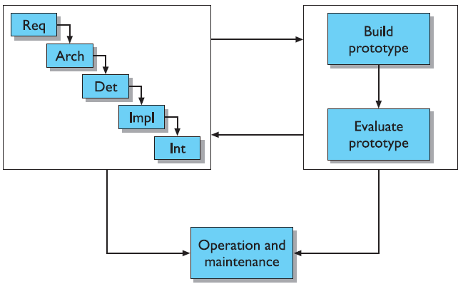
Evolutionary
Here the prototype is not discarded and serves as the basis for the next iteration of design.

Slide 41
Problems with Prototype design
Time : Building prototypes takes time
Planning : Most project managers do not have the experience with prototype design
Non-functional features : safety and reliability, response time

Slide 42
DESIGN RULES

Slide 43
PRINCIPLES
Divided into three main categories
Learnability – the ease with which new users can begin effective interaction and achieve maximal performance.
Flexibility – the multiplicity of ways in which the user and system exchange information.
Robustness – the level of support provided to the user in determining successful achievement and assessment of goals.

Slide 44
1. Learnability
Predictability
Synthesizability
Familiarity
Generalizability
Consistency

Slide 45
Predictability
user’s knowledge of the interaction history is sufficient to determine the result of his future interaction with it.
user’s ability to determine the effect of operations on the system.
supports the superiority in humans of recognition over recall.

Slide 46
Synthesizability
Ability of the user to assess the effect of past operations on the current state.
When an operation changes - the change is seen by the user.
good example of the distinction between immediacy and eventuality - command language interfaces and visual desktop interfaces
Ex: word processor operations

Slide 47
Familiarity
New user - correlation between the user’s existing knowledge and the knowledge required for effective interaction.
word processors – typewriter
Familiarity has to do with a user’s first impression of the system.
The appearance of the object stimulates a familiarity with its behavior.
Effective use of the affordances – enhance familiarity

Slide 48
Generalizability
user wants to apply knowledge that helps achieve one particular goal to another situation where the goal is in some way similar.
Generalizability can be seen as a form of consistency
Ex : cut/paste/copy operations to all applications in the same way

Slide 49
Consistency
The user relies on a consistent interface.
consistency in command naming, or consistency in command/argument invocation
familiarity can be considered as consistency with respect to past real-world experience.
input expressions or output responses with respect to the meaning of actions in some conceptual model of the system.
Ex: QWERTY keyboard

Slide 50
2. Flexibility
Flexibility refers to the multiplicity of ways in which the end-user and the system exchange information
Dialog initiative
system pre-emptive : The system can initiate all dialog, in which case the user simply responds to requests for information.
user pre-emptive : user may be entirely free to initiate any action towards the system.
maximize the user’s ability to pre-empt the system and minimize the system’s ability to pre-empt the user.

Slide 51
Multi-threading
Multi-threading of the user–system dialog allows for interaction to support more than one task at a time
Concurrent multi-threading allows simultaneous communication of information pertaining to separate tasks
Interleaved multi-threading permits a temporal overlap between separate tasks
Ex: Windows supports multithreading.
audible bell - You are editing a program when a beep indicates that a new electronic mail message has arrived

Slide 52
Task migratability
transfer of control for execution of tasks between system and user.
Spell-checking a paper is a good example of the need for task migratability

Slide 53
Substitutivity
equivalent values can be substituted for each other.
The user has the choice of what is input and what is output; in addition, output can be reused as input.

Slide 54
Customizability
modifiability of the user interface by the user or the system.
Adaptability refers to the user’s ability to adjust the form of input and output.
A system can be trained to recognize the behavior of an expert or novice and accordingly adjust its dialog control or help system automatically to match the needs of the current user.

Slide 55
3. Robustness
Observability :five other principles:
Browsability -explore the current internal state of the system, provided at the interface
Defaults - can assist the user by passive recall
Reachability - user can navigate from any given state to any other state
Persistence - duration of the effect of a communication
operation visibility – ability to reach a desired goal after recognition of some error in a previous interaction

Slide 56
Responsiveness
Responsiveness measures the rate of communication between the system and the user.
duration of time needed by the system to express state changes to the user.
Stability - pull-down menus are expected to pop up instantaneously as soon as a mouse button is pressed

Slide 57
Task conformance
allow a user to perform various tasks in achieving certain goals within a specific application domain.
whether the system supports all of the tasks of interest

Slide 58
Shneiderman’s Eight Golden Rules of Interface Design

Slide 59
Shneiderman’s 8 Golden Rules
1. Strive for consistency
2. Cater to Universal Usability (Enable frequent users to use shortcuts)
3. Offer informative feedback
4. Design dialogs to yield closure
5. Offer error prevention and simple error handling
6. Permit easy reversal of actions
7. Support internal locus of control
8. Reduce short-term memory load

Slide 60
Eight Golden Rules
1. Strive for consistency in action sequences, layout, terminology, command use and
so on.
2. Enable frequent users to use shortcuts, such as abbreviations, special key sequences and macros, to perform regular, familiar actions more quickly.
3. Offer informative feedback for every user action, at a level appropriate to the magnitude of the action.
4. Design dialogs to yield closure so that the user knows when they have completed a task.

Slide 61
5. Offer error prevention and simple error handling so that, ideally, users are prevented from making mistakes and, if they do, they are offered clear and informative instructions to enable them to recover.
6. Permit easy reversal of actions in order to relieve anxiety and encourage exploration, since the user knows that he can always return to the previous state.
7. Support internal locus of control so that the user is in control of the system, which responds to his actions.
8. Reduce short-term memory load by keeping displays simple, consolidating multiple page displays and providing time for learning action sequences.

Slide 62
Norman’s 7 Principles
1. Use both knowledge in the world and knowledge in the head.
2. Simplify the structure of tasks.
3. Make things visible: bridge the gulfs of execution and evaluation.
4. Get the mappings right.
5. Exploit the power of constraints, both natural and artificial.
6. Design for error.
7. When all else fails, standardize.

